Slide 1
Introduction to Commuting Local Hamiltonian Problem
Jiaqing Jiang
California Institute of Technology
2024.3.19
Based on [Bravyi-Vyalyi03] [Schuch11]
[Aharonov-Kenneth-Vigdorovich18] [Irani-Jiang23]

Slide 2
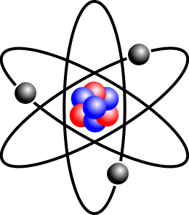
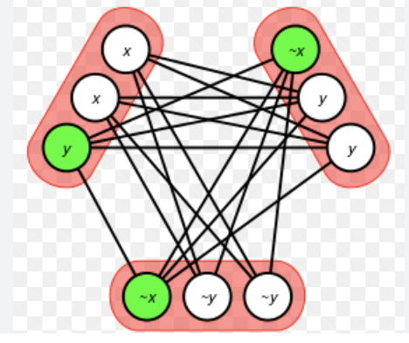
A philosophy question…
(??) SAT-Solver
Quantum world
Quantum Chemistry
(Challenging…)
Classical world
3-SAT..
(Many SAT-Solvers…)
What makes quantum problem inherently different from classical?
Uncertainty principle: non-Commuting $⇔$ Quantum
Today: Relationship between Commuting & Hardness of quantum problems

Slide 3
Outline
Commuting Local Hamiltonian problems (CLHP) [Bravyi-Vyalyi03]
More Motivation
Overview of results
Statement of the Structure Lemma
2-local CLHP
Toric code & 4-local 2D CLHP
Notes:
A key technique, structure lemma, 2-local

Slide 4

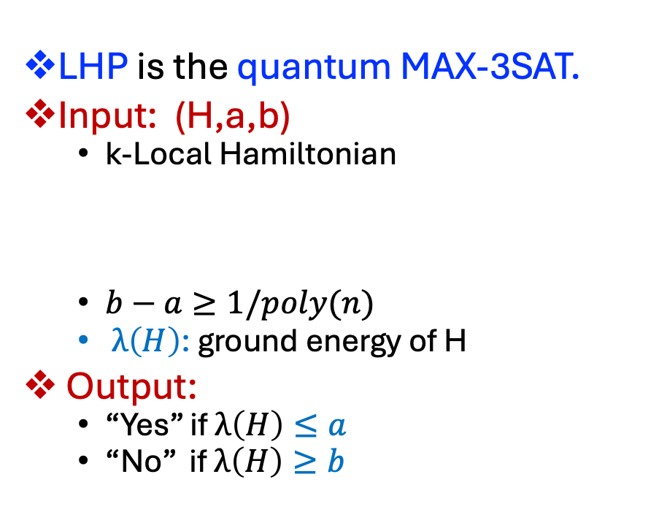

Local Hamiltonian problems (LHP)
LHP is the quantum MAX-3SAT.
Input: (H,a,b)
k-Local Hamiltonian
$b−a≥1/poly(n)$
$λ\left(H\right)$: ground energy of H
Output:
“Yes” if $λ\left(H\right)≤a$
“No” if $λ\left(H\right)≥b$
n qudits, k=3
$$H =h1 + … +hm$$
$n$-qudit Hermitian
h_{i}
k-qudit
LHP is QMA-Complete (quantum NP)
[KKR06]

Slide 5
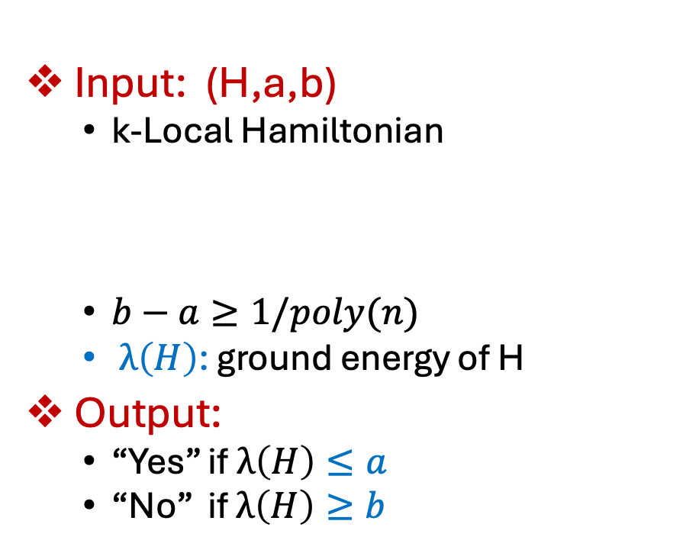


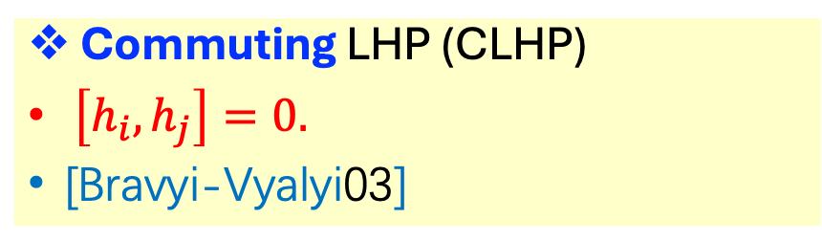
Commuting LHP
Input: (H,a,b)
k-Local Hamiltonian
$b−a≥1/poly(n)$
$λ\left(H\right)$: ground energy of H
Output:
“Yes” if $λ\left(H\right)≤a$
“No” if $λ\left(H\right)≥b$
Commuting LHP (CLHP)
$\left[h_{i}, h_{j}\right]=0.$
[Bravyi-Vyalyi03]
$$H =h1 + … +hm$$
$n$-qudit Hermitian
k-qudit
Examples:
3-SAT
Toric code, CSS code
Quantum double model

Slide 6
Is CLHP quantum (QMA) or classical (NP)? Intuitive reasons
NP-Complete
Classical
“Simple” but quantum
SAT
CLHP
Uncertainty principle

Slide 7
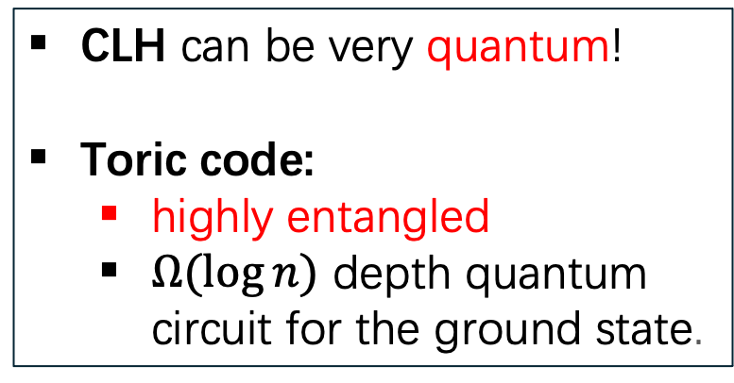
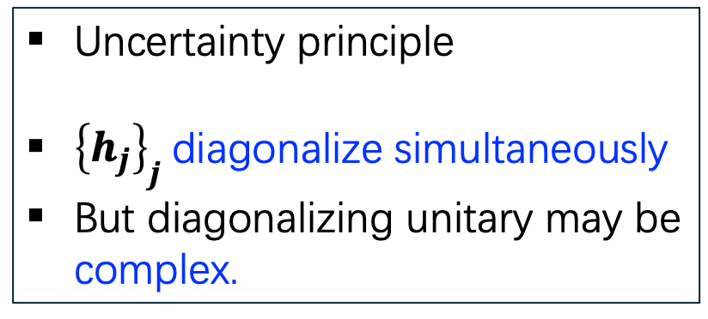
Is CLHP quantum (QMA) or classical (NP)? Intuitive reasons
NP-Complete
Classical
QMA1-Complete
Quantum.
“Simple” but quantum
SAT
CLHP
LHP
Uncertainty principle
${\left\{h_{j}\right\}}_{j}$diagonalize simultaneously
But diagonalizing unitary may be complex.
CLH can be very quantum!
Toric code:
highly entangled
$Ω(\log{n)}$ depth quantum circuit for the ground state.

Slide 8

Main problem
CLHP: “Simple” but quantum
Complexity of CLHP:
NP? QMA1? QCMA?
Ground state of CLH:
Easy or hard to prepare?
Easy: Trivial ground state, constant-depth quantum circuit.

Slide 9
Reasons to be interested in CLH
CLH: “Simple” but quantum
Complexity
Physics
Topological order
Error correcting codes
Stabilizer codes
Self-correcting Quantum memory
[BT09][AHHH08]
Test ground for hard problems:
Quantum PCP [AE13] [ABN22]
Mixing time for Gibbs preparation
(Thermalization) [KB16] [BCG+23]
Quantum Lovasz Local Lemma
(Ground state preparation) [GS17]

Slide 10
Overview of known results
“Some special case of CLHP is in NP”
2-local, qudit [Bravyi-Vyalyi03]
3-local, qubits + qutrits (“Nearly Euclidean”) [Aharonov-Eldar11]
4-local, 2D, qubits [Schuch11]
[Aharonov-Kenneth-Vigdorovich18]
4-local, 2D, qutrits [Irani-Jiang23]
Factorized, qubits, [Bravyi-Vyalyi03]
Factorized-2D, qudits, [Irani-Jiang23]
“Classical”
Trivial ground state
“Quantum”
No trivial ground state
Notes:
The CLHP was first introduced by Bravyi-Vyalyi in 2003, where they show that 2-local qudit CLHP is in NP.

Slide 11
Overview of known results
“Some special case of CLHP is in NP”
2-local, qudit [Bravyi-Vyalyi03] (constructive)
3-local, qubits + qutrits (“Nearly Euclidean”) [Aharonov-Eldar11]
4-local, 2D, qubits [Schuch11]
[Aharonov-Kenneth-Vigdorovich18] (constructive)
4-local, 2D, qutrits [Irani-Jiang23]
Factorized, qubits, [Bravyi-Vyalyi03]
Factorized-2D, qudits, [Irani-Jiang23] (constructive)
“Classical”
Trivial ground state
“Quantum”
No trivial ground state
Next talk: Isaac & Daniel classification of 2D gapped ground states ground states of CLHs.

Slide 12
Overview of known results
“Some special case of CLHP is in NP”
2-local, qudit [Bravyi-Vyalyi03] (constructive)
3-local, qubits + qutrits (“Nearly Euclidean”) [Aharonov-Eldar11]
4-local, 2D, qubits [Schuch11]
[Aharonov-Kenneth-Vigdorovich18] (constructive)
4-local, 2D, qutrits [Irani-Jiang23]
Factorized, qubits, [Bravyi-Vyalyi03]
Factorized-2D, qudits, [Irani-Jiang23] (constructive)
“Classical”
Trivial ground state
“Quantum”
No trivial ground state
Is CLHP in NP? QCMA? QMA?
Tool box & Technical challenges.

Slide 13
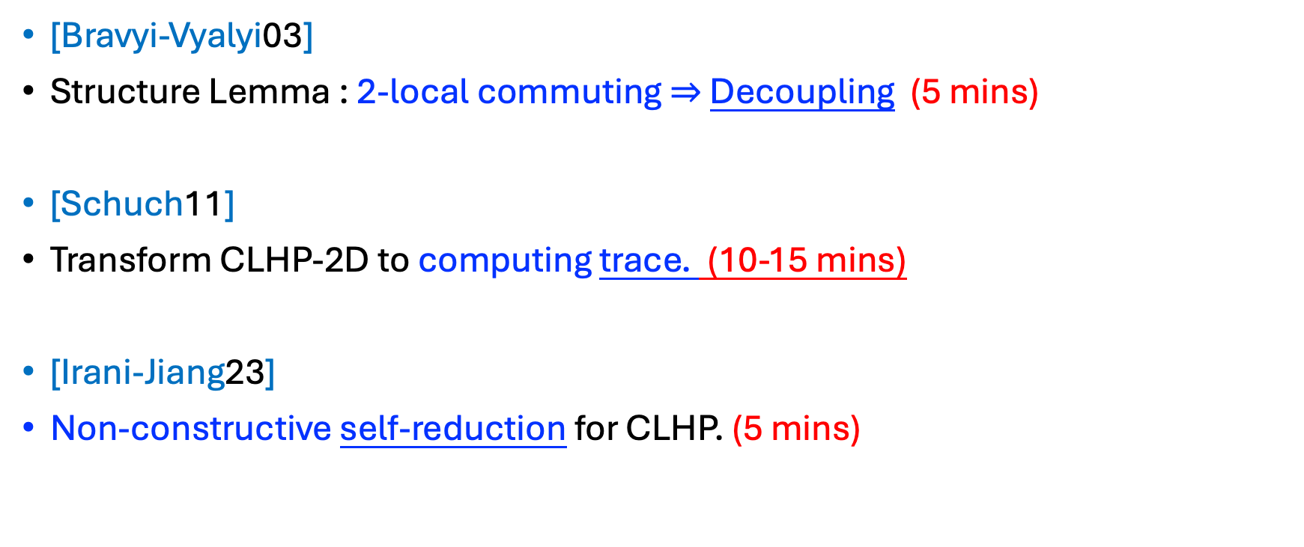
Toolbox covered in this talk
[Bravyi-Vyalyi03]
Structure Lemma : 2-local commuting $⇒$ Decoupling (5 mins)
[Schuch11]
Transform CLHP-2D to computing trace. (10-15 mins)
[Irani-Jiang23]
Non-constructive self-reduction for CLHP. (5 mins)

Slide 14
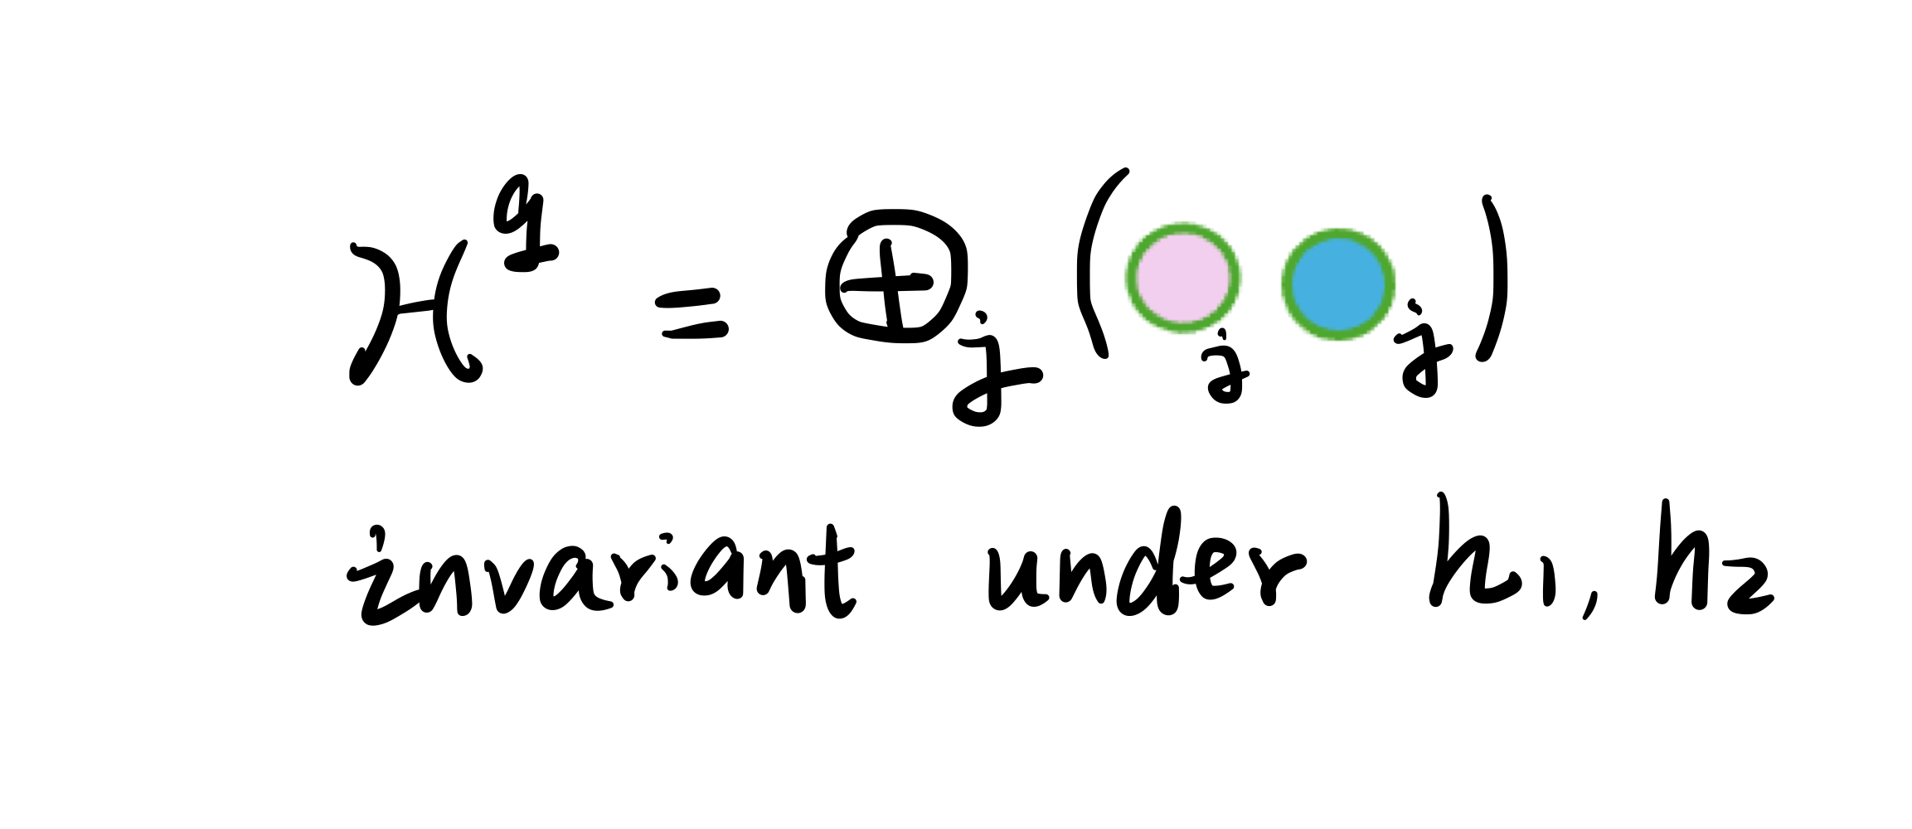



The structure Lemma [BV03]
2-local commuting $⇒$ Decoupling
h₁
h₂
(?) Ground state of $h_{1}+h_{2}$
q₁
q
q₂
$\left[h_{1},h_{2}\right]=0 ⇒$ Decoupling
GS of $h_{1}+h_{2}$ can be prepared
by constant depth circuit.
If no overlap.
GS: Tensor of 2-qudit state

Slide 15
The structure Lemma [BV03]
More general 2-local interaction
2-local CLH: Trivial ground state, prepared by constant depth circuit.
NP witness: constant depth circuit for GS (constructive proof)

Slide 16
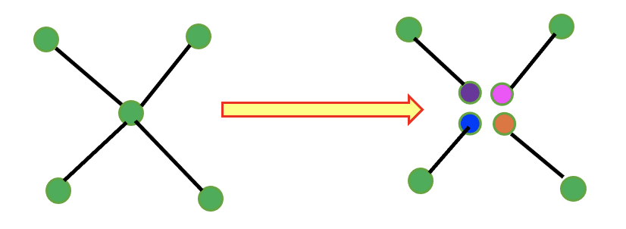
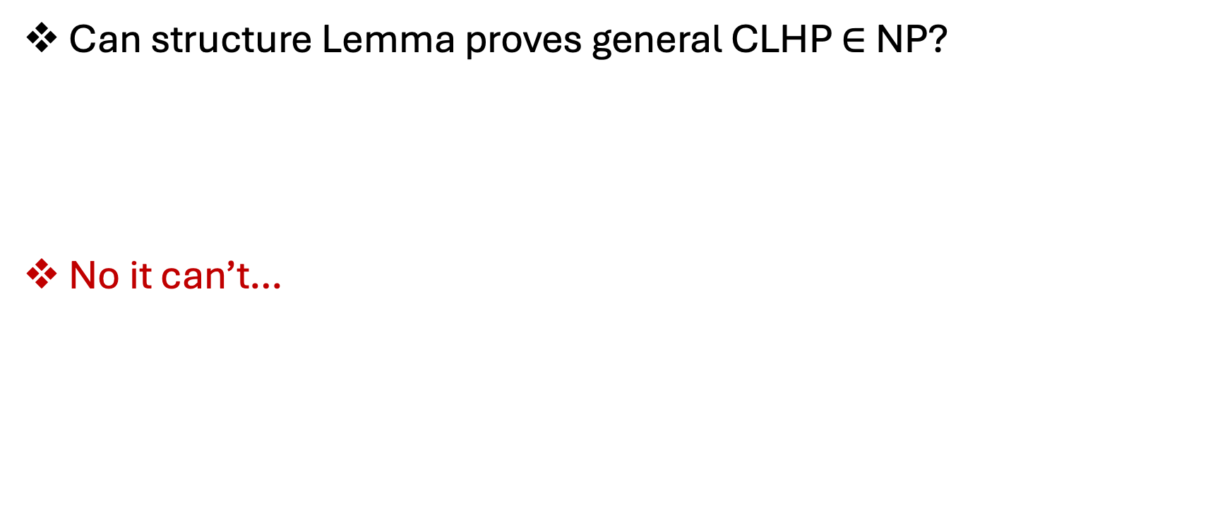
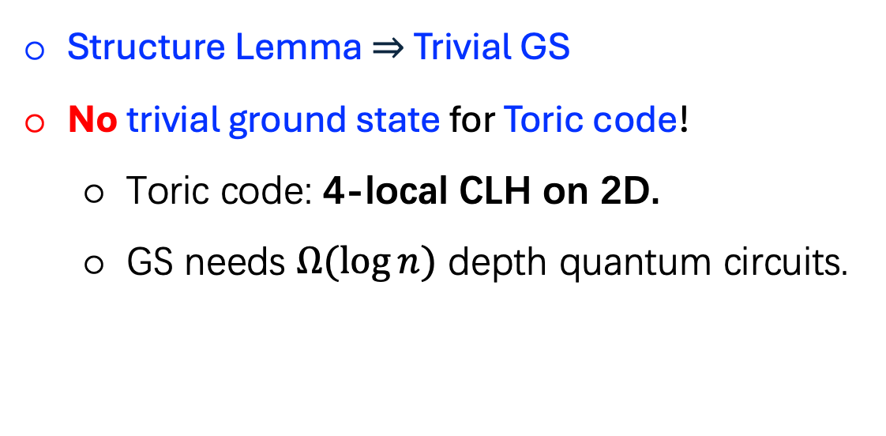
Limitation of structure lemma
Can structure Lemma proves general CLHP $∈$ NP?
No it can’t…
Structure Lemma $⇒$ Trivial GS
No trivial ground state for Toric code!
Toric code: 4-local CLH on 2D.
GS needs $Ω(\log{n})$ depth quantum circuits.

Slide 17
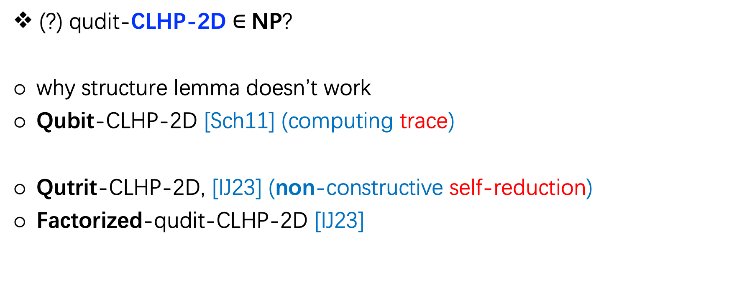
Outline: New ideas for qudit-CLHP-2D
(?) qudit-CLHP-2D $∈$NP?
why structure lemma doesn’t work
Qubit-CLHP-2D [Sch11] (computing trace)
Qutrit-CLHP-2D, [IJ23] (non-constructive self-reduction)
Factorized-qudit-CLHP-2D [IJ23]

Slide 18
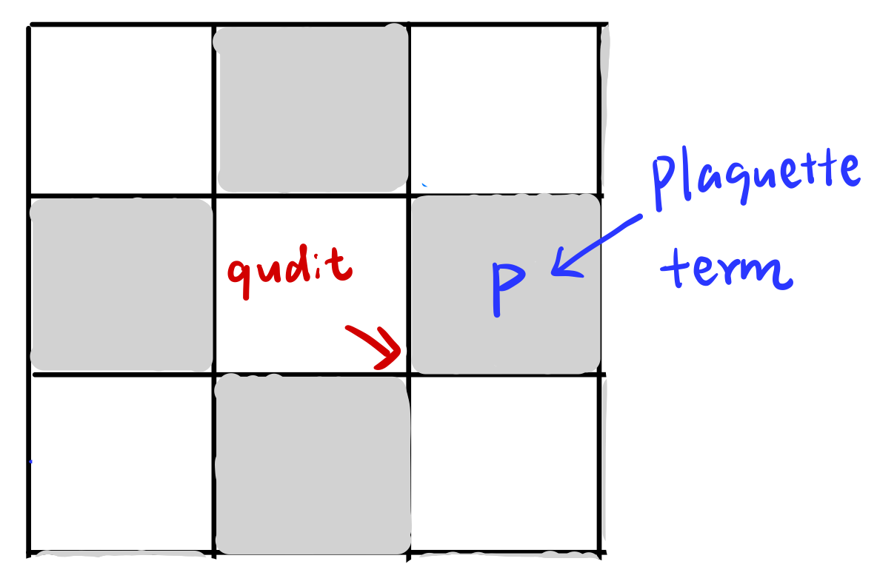
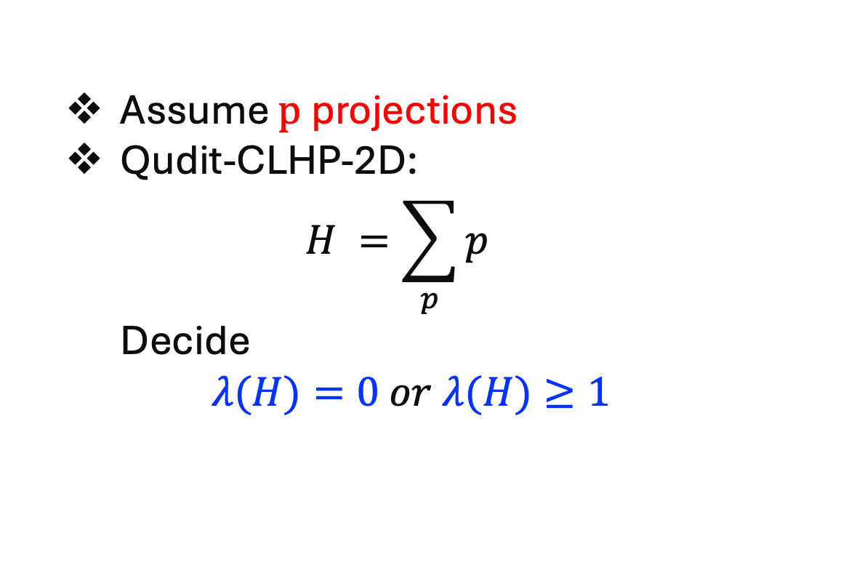

Qudit-CLHP-2D
Assume $p \text{projections}$
Qudit-CLHP-2D:
$$H =\sum_{p}{p}$$
Decide
$$λ(H)=0 or λ(H)≥1$$
Goal: Prove qubit-CLHP-2D $∈$NP
Certify $λ(H)=0$ classically.

Slide 19
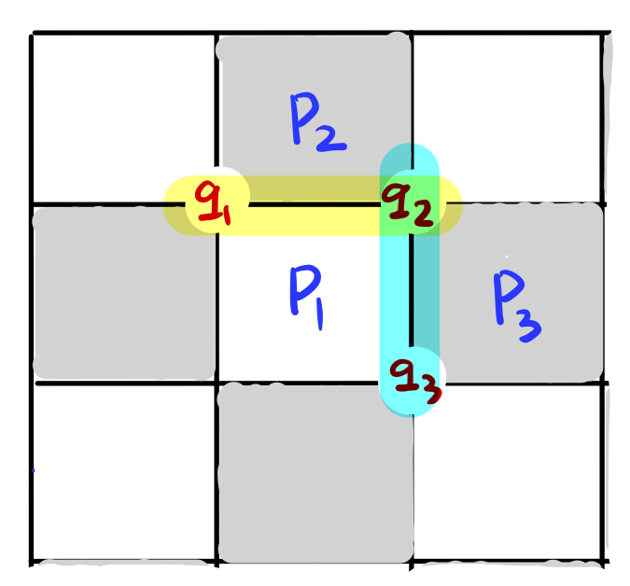
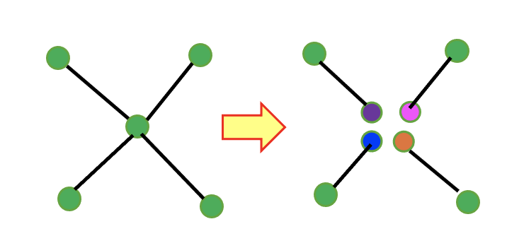
Why structure Lemma doesn’t work?
4-local
Incompatible decomposition
2-local
star-like interaction

Slide 20
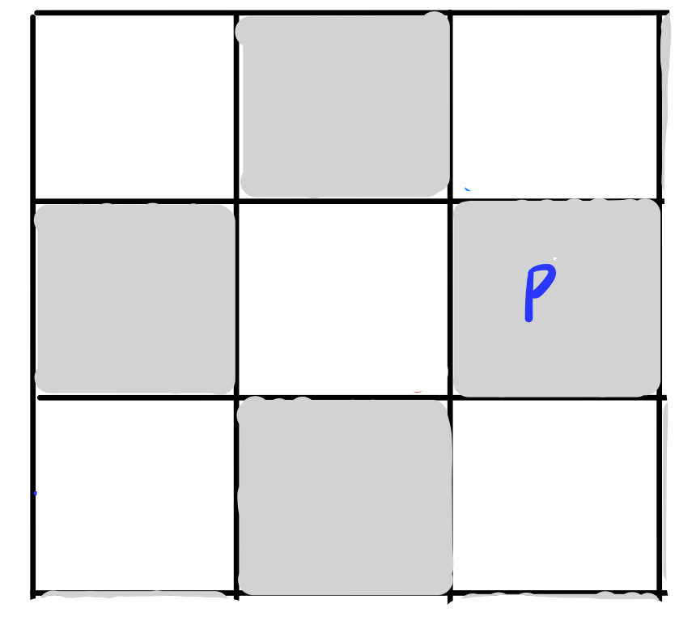
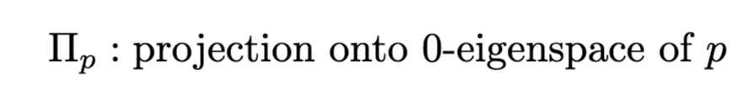
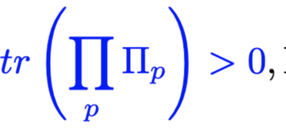
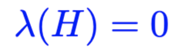

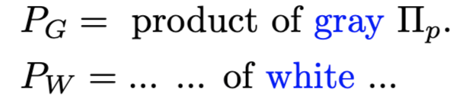
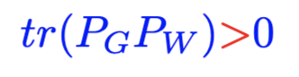

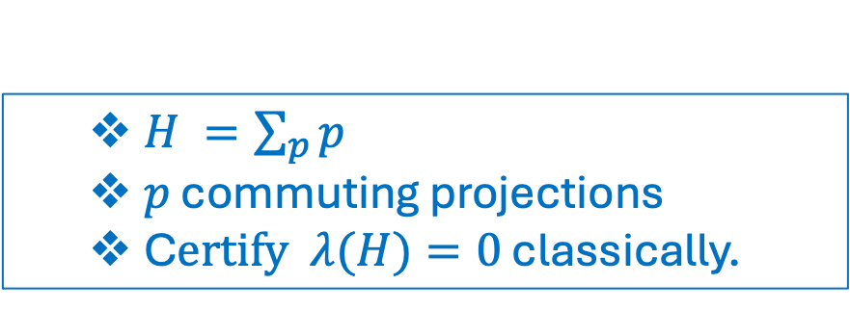
[Sch11] Non-constructive proof for qubit-CLHP-2D $∈$ NP
[Sch11] Transform the CLHP-2D to computing trace.
$H =\sum_{p}{p}$
$p$ commuting projections
C$ertify λ(H)=0$ classically.

Slide 21
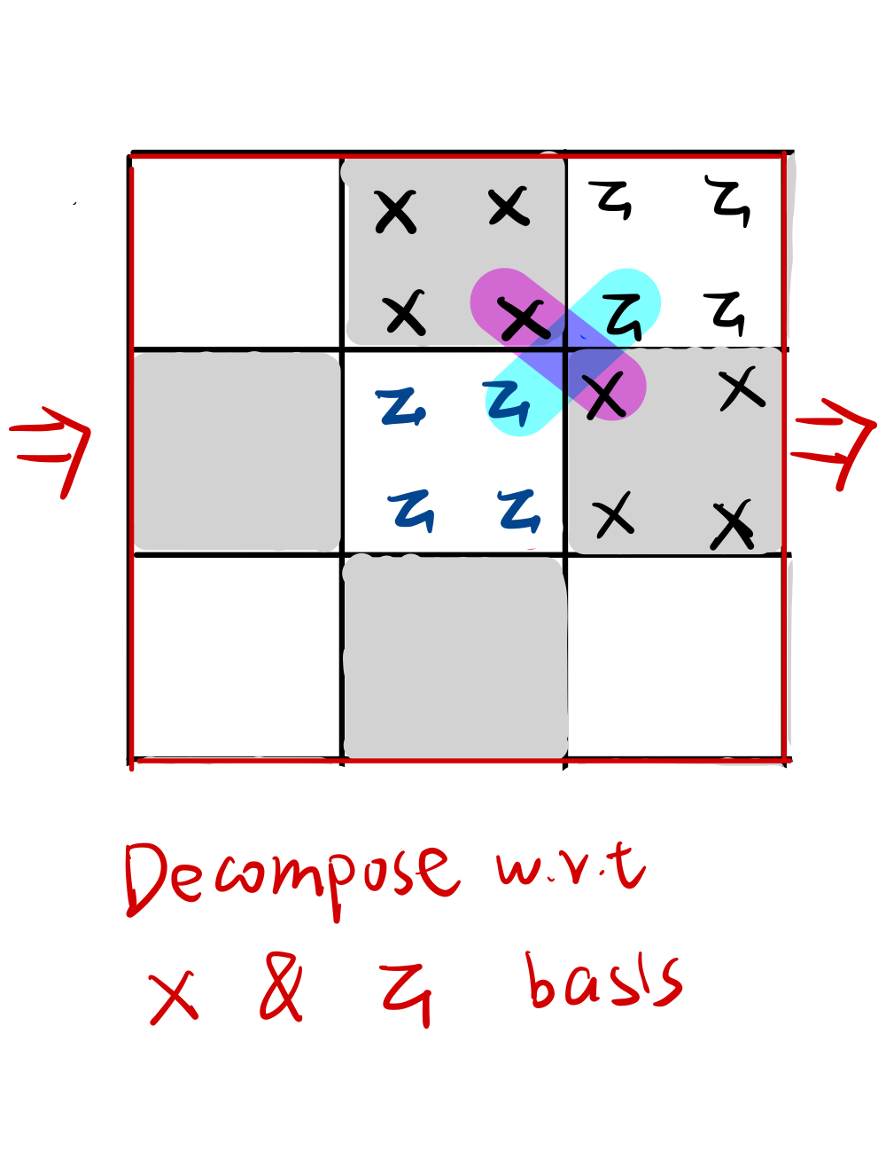
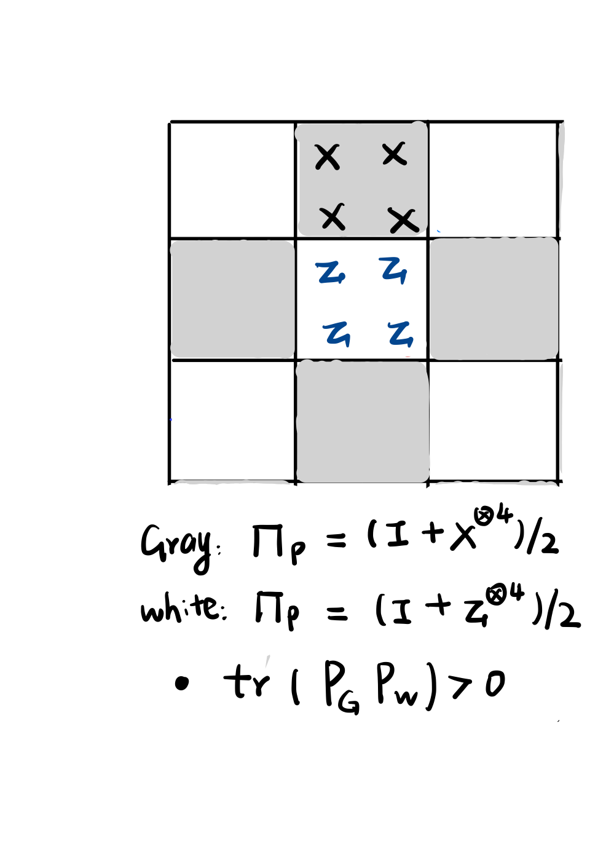
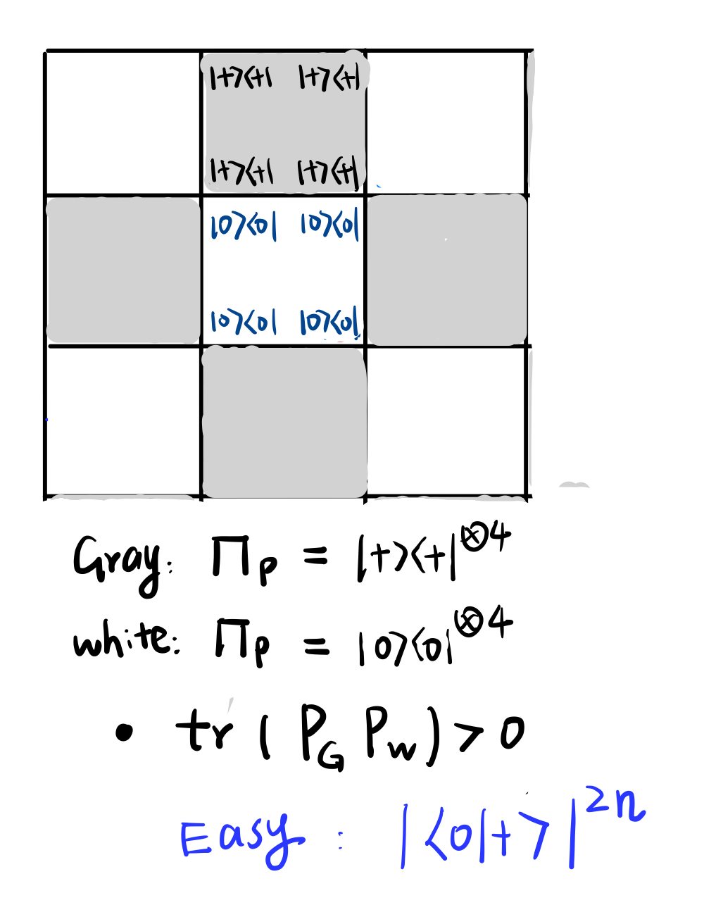
Why proving trace is easier?
Take Toric code as an example

Slide 22
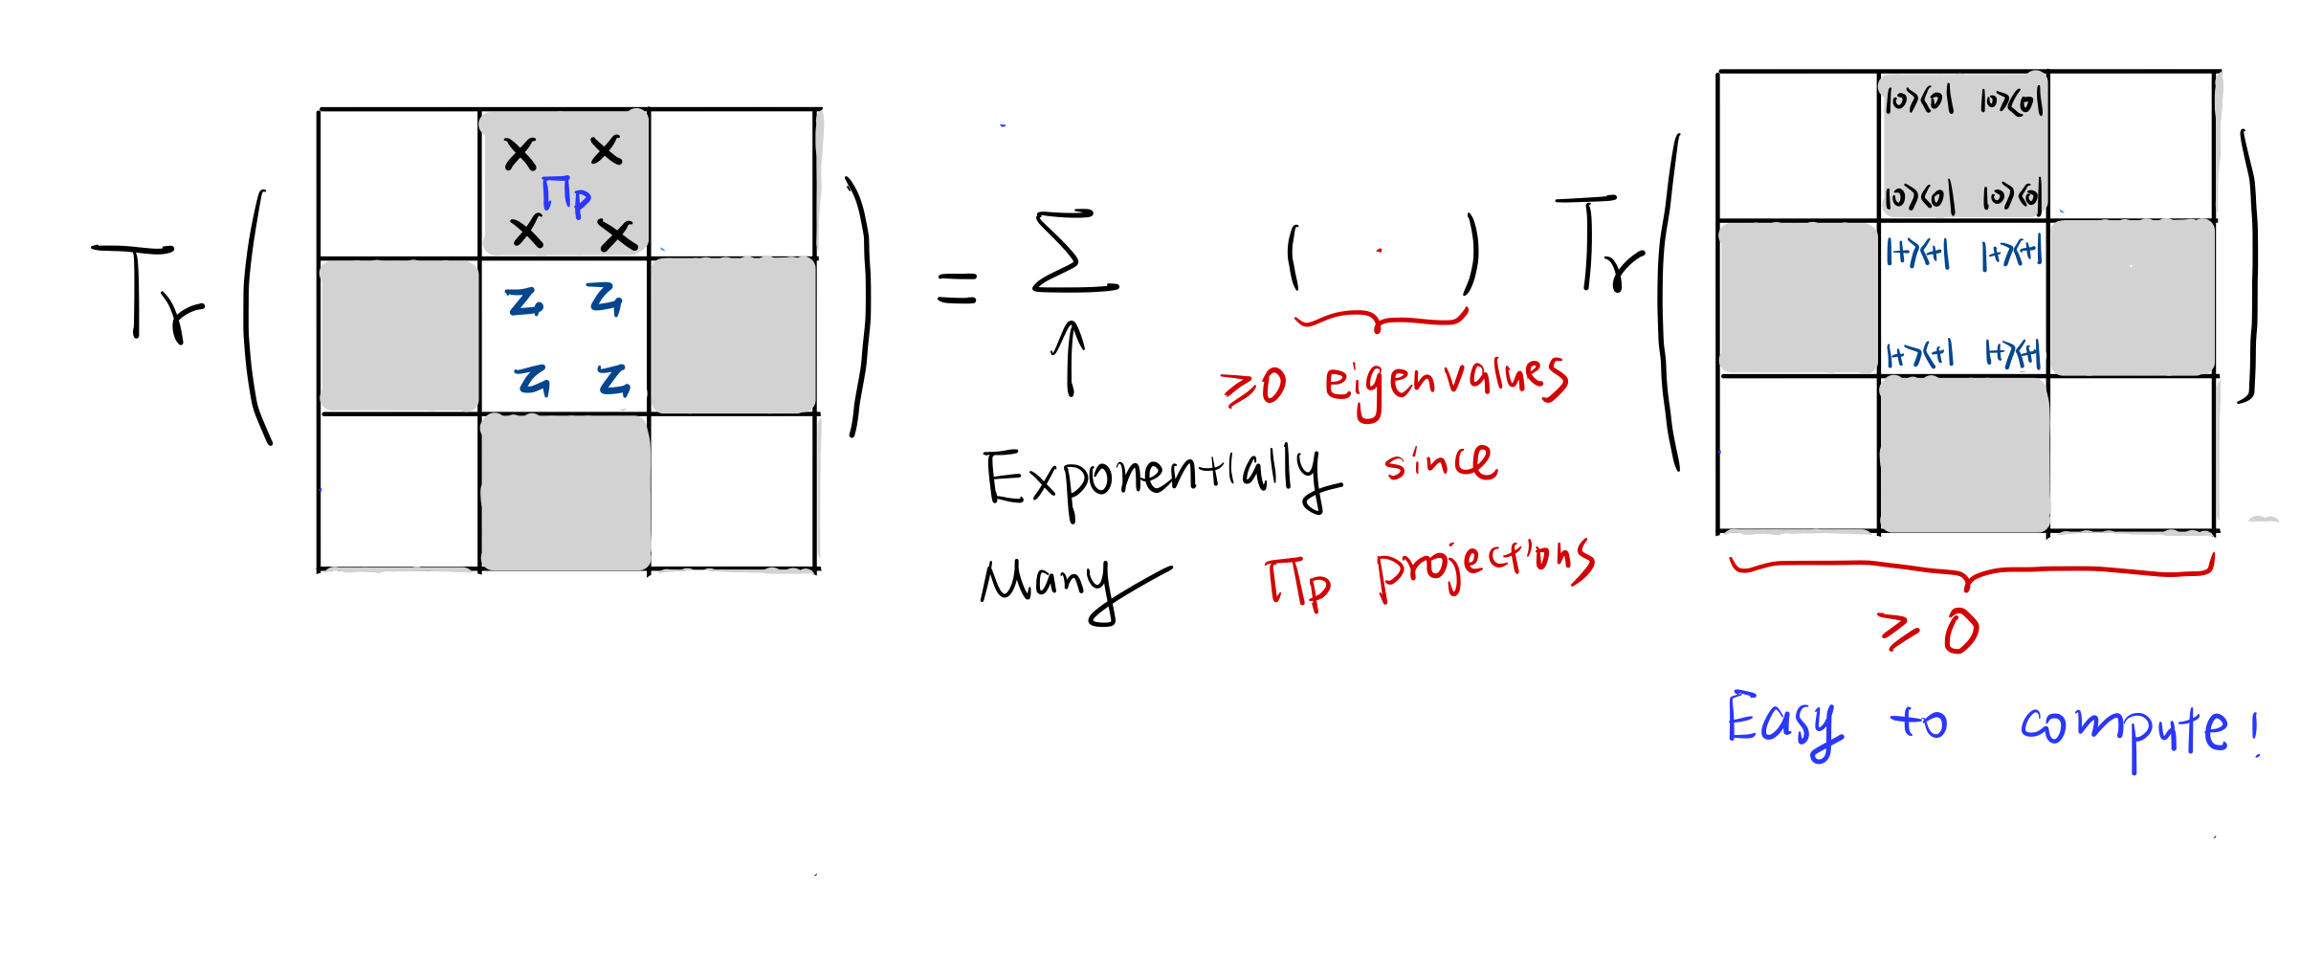
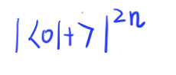

Why proving trace is easier? Take Toric code as an example
Proving $∑$ non-negative terms >0 is equivalent to proving one term >0!
NP witness: index of one non-negative term.

Slide 23
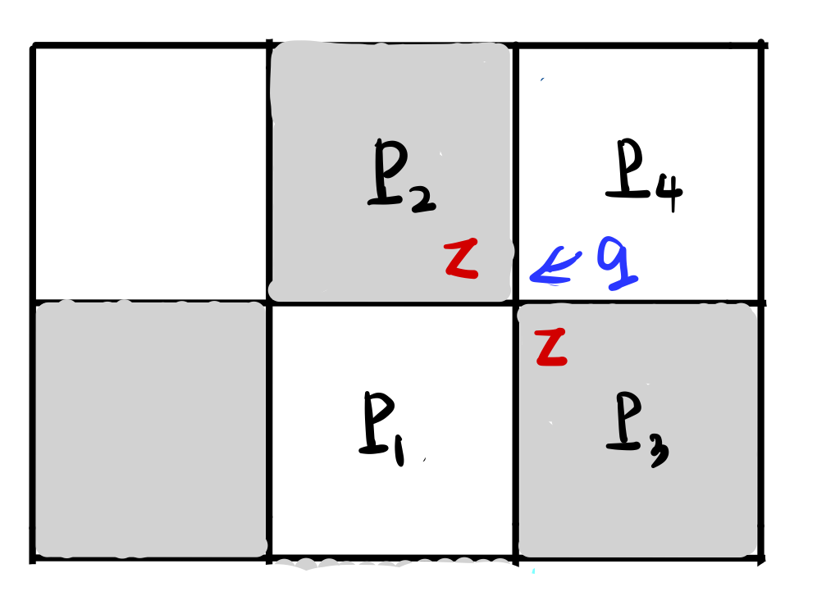
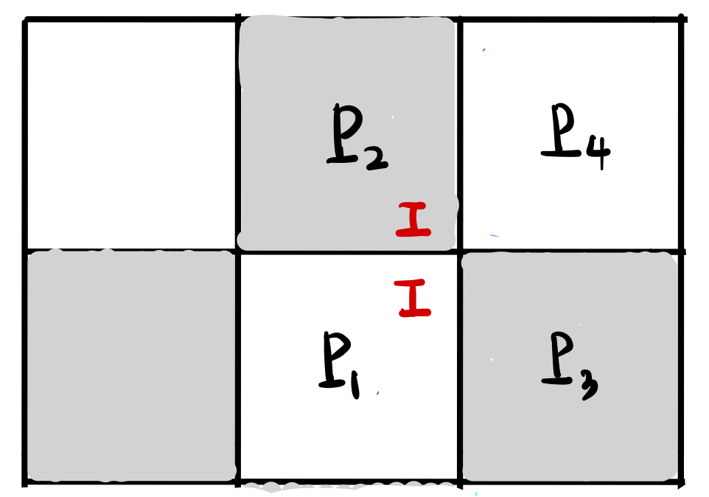
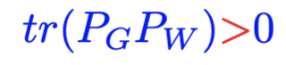


Qubit-CLHP-2D in NP
General qubit-CLHP-2D: classify qubits
(a) Similar to Toric code
(b) two terms acts as Identity on q.
Decompose the trace w.r.t to all qubits in (a)
Each sub-trace will be of 1D structure because of the identity.

Slide 24
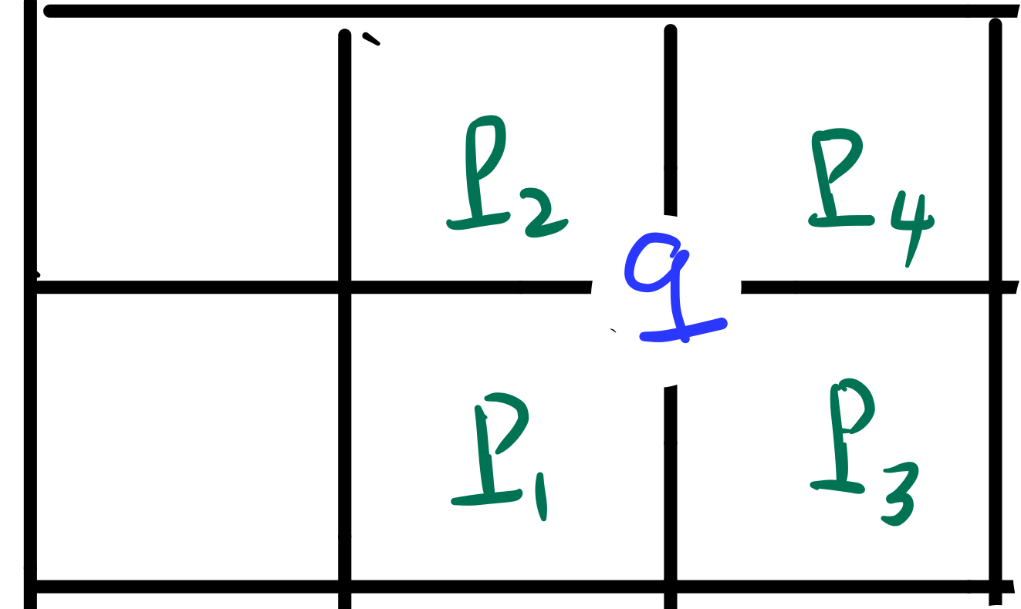
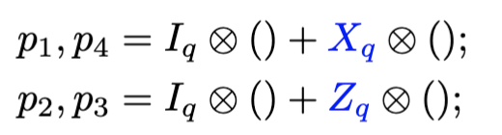

Qubit-CLHP-2D: Equivalence to Toric code permitting boundary Constructive proof [AKV18]
Ground state can be prepared similarly as Toric code
by poly-size quantum circuit.
“Measure & Correct.”
“Interior qubit” q: $p_{1},p_{2},p_{3},p_{4}$ act non-trivially on q.

Slide 25
4-local: qubit to qudit.
Qudit/Qutrit is very different from qubit.
+1 dimension introduces degeneracy.
Sub-trace: 1D structure.

Slide 26

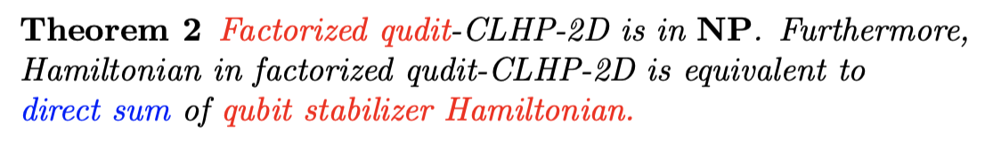
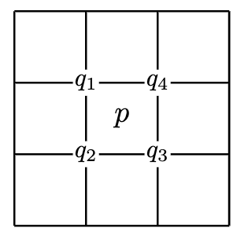

New for 4-local qudit [IJ23]
Non-constructive proof.
“rounding” for self-reduction
$p=p^{q_{1}}⊗p^{q_{2}}⊗p^{q_{3}}⊗p^{q_{4}}$

Slide 27
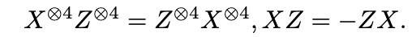
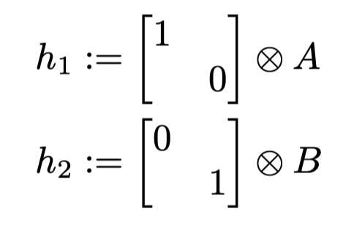
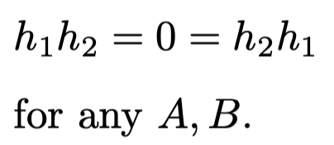
4-local qudit [IJ23]
Non-constructive proof.
“rounding” for self-reduction
Factorized Hamiltonian can look very different from stabilizer Hamiltonian.
Stabilizer H: Regular way of commuting
Factorized H: Singular way of commuting
We prove the ground space of factorized-CLHP looks like stabilizer Hamiltonian.

Slide 28

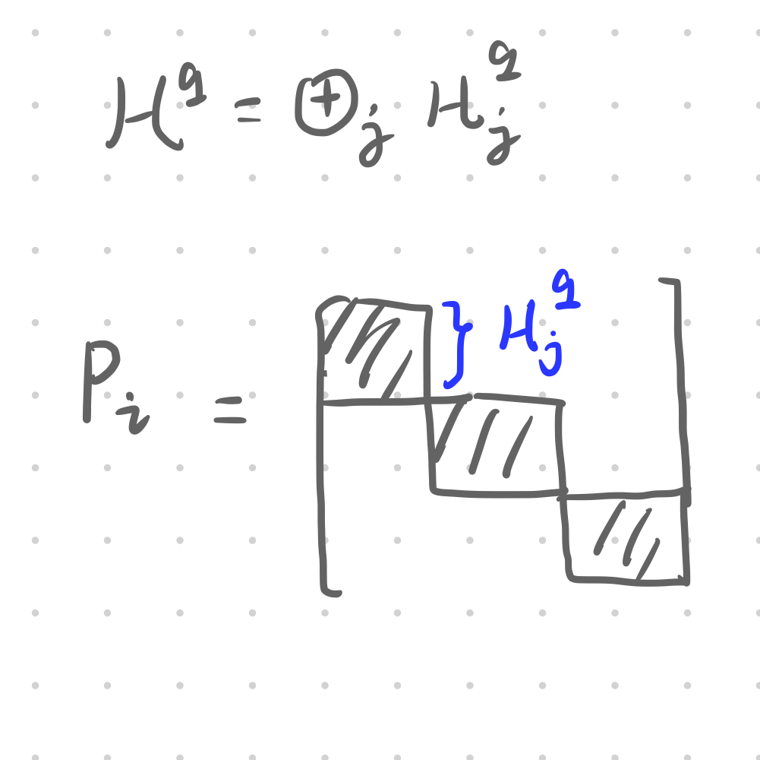
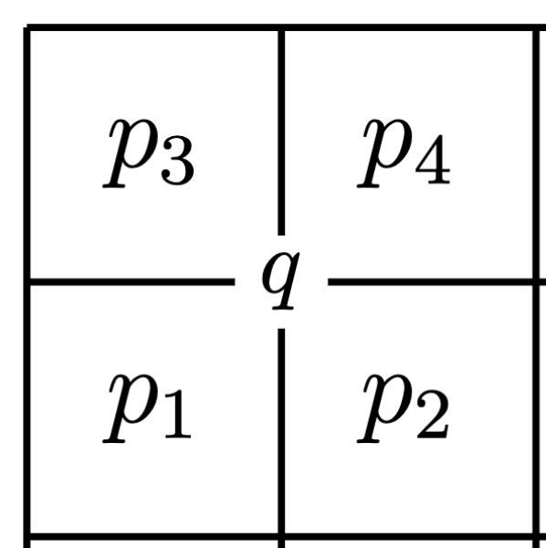
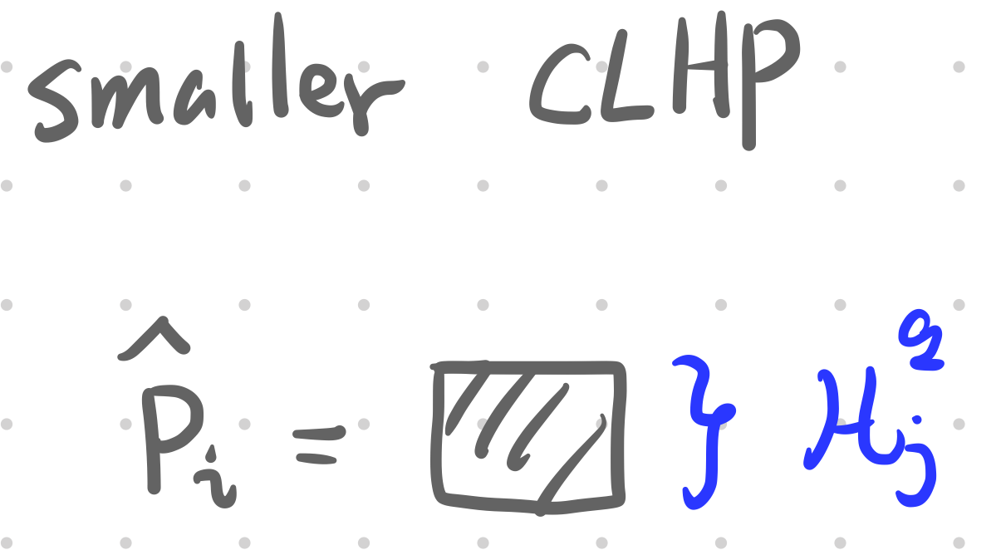
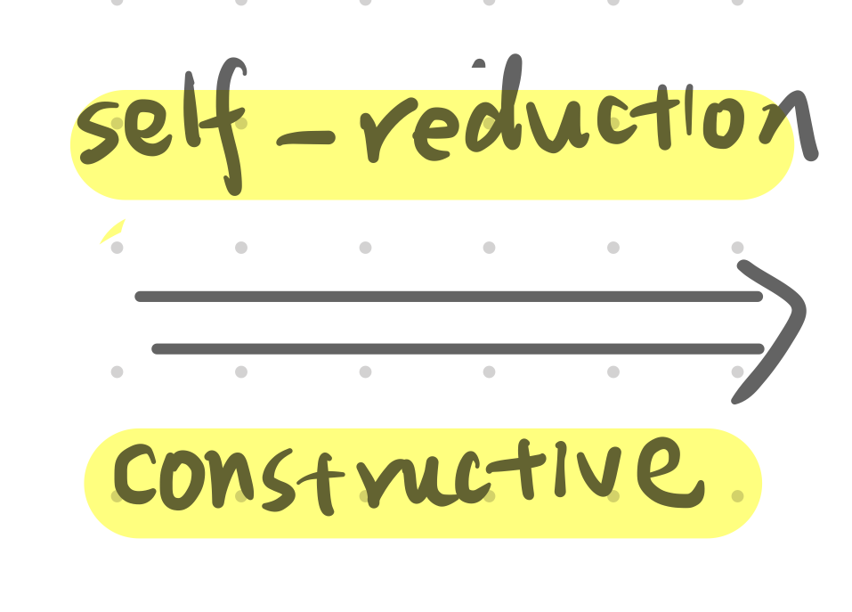
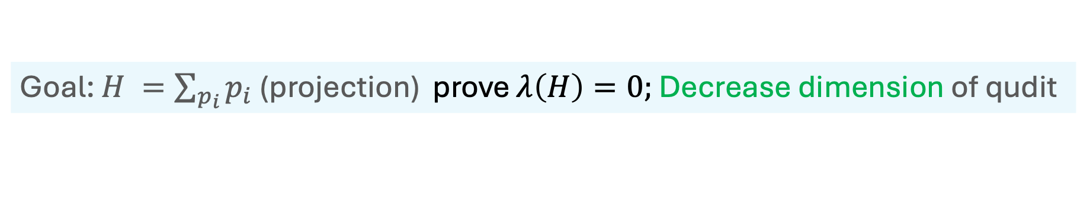
Key technique for qutrit-CLHP-2D in NP Non-constructive self-reduction for CLHP: qutrit to qubit?
Goal: $H =\sum_{p_{i}}{p_{i} }$(projection) prove $λ\left(H\right)=0;$ Decrease dimension of qudit

Slide 29

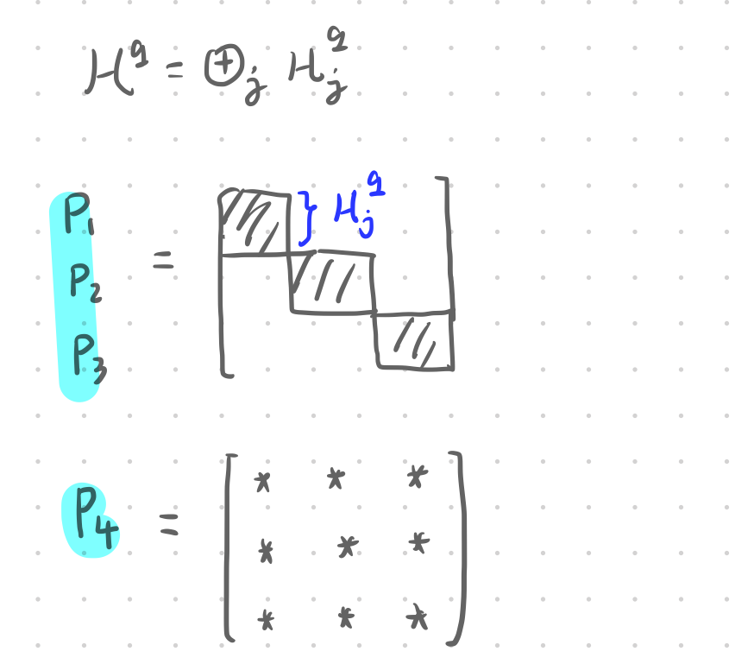
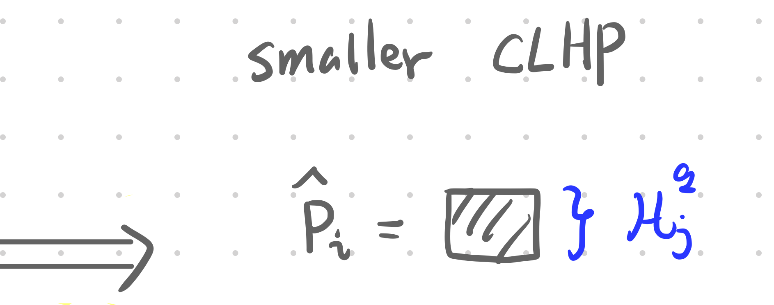
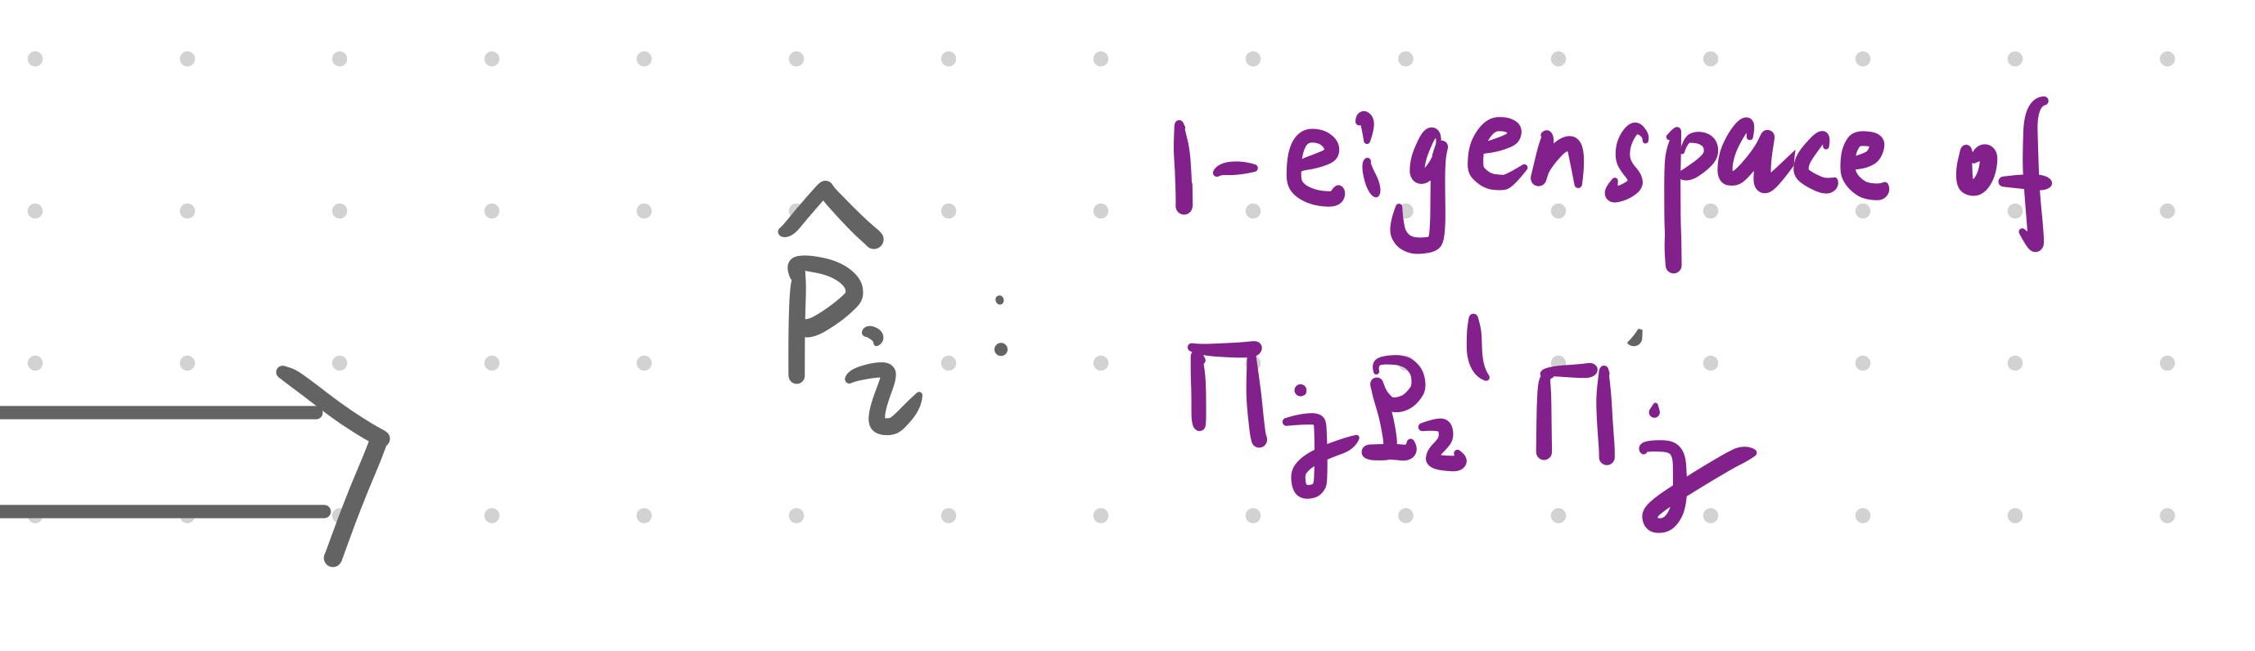
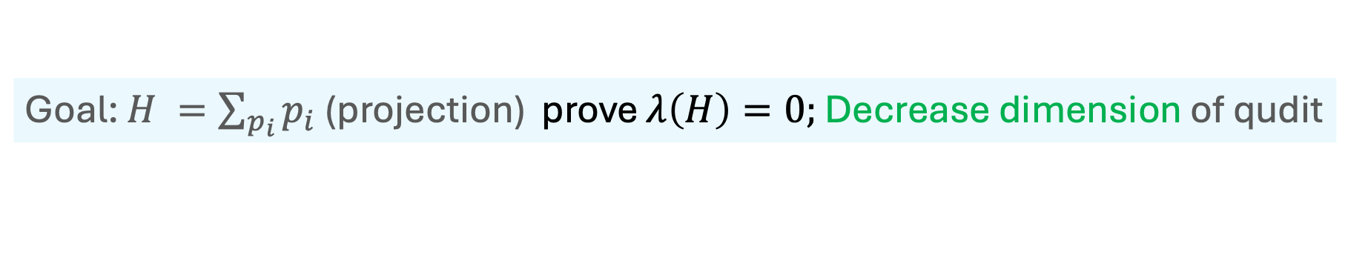
Key technique for qutrit-CLHP-2D in NP Non-constructive self-reduction for CLHP: qutrit to qubit?
Goal: $H =\sum_{p_{i}}{p_{i} }$(projection) prove $λ\left(H\right)=0;$ Decrease dimension of qudit
For CLHP we can do more!

Slide 30

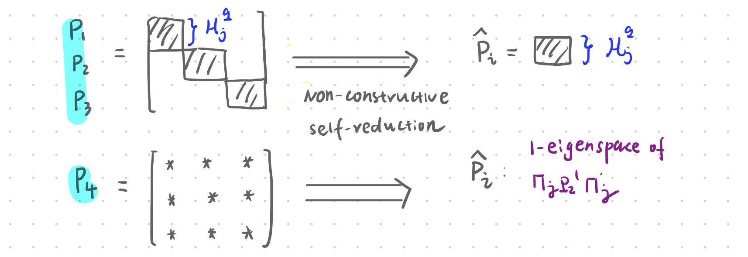
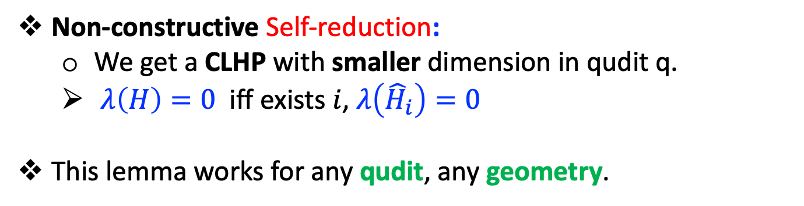
Non-constructive Self-reduction:
We get a CLHP with smaller dimension in qudit q.
$λ\left(H\right)=0$ iff exists $i$, $λ\left({\hat{H}}_{i}\right)=0$
This lemma works for any qudit, any geometry.

Slide 31


Open problems
Thanks for listening. Question?
“Some special case of CLHP is in NP”
Qudit-CLHP-2D:
Complexity & Ground state preparation
In NP? Non-trivial class in QCMA?
Can GS be prepared by poly-size quantum circuit?
(?) 2D Area Law $⇒$poly-size quantum circuit?
2D Area law: for GS, entanglement entropy across any cut is proportional to the boundary.
2D Area law (?) poly-size ground state (?)
Qudit-CLHP-2D: Area law (yes) & poly-size ground state (?)

Slide 32
Reference
[ABN22] Anurag Anshu, Nikolas Breuckmann, and Chinmay Nirkhe. Nlts hamiltonians from good quantum codes.
[AE11] Aharonov, Dorit, and Lior Eldar. "On the complexity of commuting local Hamiltonians, and tight conditions for topological order in such systems." 2011 IEEE 52nd Annual Symposium on Foundations of Computer Science. IEEE, 2011.
[AE13] Dorit Aharonov and Lior Eldar. The commuting local hamiltonian on locally-expanding graphs is in NP.
[KB16] Michael J Kastoryano and Fernando GSL Brandao. Quantum gibbs samplers: The commuting case.
[BCG+23] Ivan Bardet, Angela Capel, Li Gao, Angelo Lucia, David P´erez-Garc´ıa, and Camb ´ yse Rouz´e. Rapid thermalization of spin chain commuting hamiltonians.
[GS17] Gilyén, András Pál, and Or Sattath. "On preparing ground states of gapped hamiltonians: An efficient quantum Lovász local lemma." 2017 IEEE 58th Annual Symposium on Foundations of Computer Science (FOCS). IEEE, 2017

Slide 33
[BT09] Bravyi, Sergey, and Barbara Terhal. "A no-go theorem for a two-dimensional self-correcting quantum memory based on stabilizer codes." New Journal of Physics 11.4 (2009): 043029
[AHHH08] Alicki, Robert, et al. "On thermal stability of topological qubit in Kitaev's 4D model." Open Systems & Information Dynamics 17.01 (2010): 1-20.
[BV03] Sergey Bravyi and Mikhail Vyalyi. Commutative version of the k-local hamiltonian problem and common eigenspace problem.
[Sch11] Norbert Schuch. Complexity of commuting hamiltonians on a square lattice of qubits.
[AKV18] Dorit Aharonov, Oded Kenneth, and Itamar Vigdorovich. On the complexity of two dimensional commuting local hamiltonians.

